Slide 1
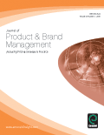
The Effect of Product Category on Consumer Brand Relationships
Dr. Marc Fetscherin, Rollins College, USA
Dr. Michele Boulanger, Rollins College, USA
Dr. Cid Gonçalves Filho, FUMEC University, Brazil
Dr. Gustavo Souki, UNA/DataConsumer, Brazil
Article accepted in
Journal of Product and Brand Management, Vol. 23, No. 1. (2014 forthcoming)
*
Notes:
SW-SW-CMZ008-2001-09-27-MFE
*

Slide 2
Agenda
Introduction
Literature Review
Theoretical Framework and Hypotheses
Methodology and Results
Conclusion and Limitation
*
Notes:
SW-SW-CMZ008-2001-09-27-MFE
*

Slide 3
Introduction
Among the consumer brand relationship facets studied, brand love is one of the most recent and least researched
Despite the effect of product category in the branding literature, little is known whether brand love is universally applicable to any product category or if it’s product category specific
The purpose of this study is to address this by comparing four different product categories (soft drinks, mobile phones, shoes and cars) and conducted a survey with 800 respondents
*
Notes:
SW-SW-CMZ008-2001-09-27-MFE
*

Slide 4
Agenda
Introduction
Literature Review
Theoretical Framework and Hypotheses
Methodology and Results
Conclusion and Limitation
*
Notes:
SW-SW-CMZ008-2001-09-27-MFE
*

Slide 5
Consumer Brand Relationships
Consumer brand relationship research is multi-disciplinary, complex, dynamic and “many unresolved issues and conundrums remain” (Fournier, 2009, p. 5)
Brands as relationship partners (Keh et al., 2007) with many different relationship constructs (Fournier, 1998)
Various types and intensities of emotions and relationships consumers have with brands brand loyalty (Jacoby and Chestnut, 1978)
brand trust (Chaudhuri and Holbrook, 2001),
brand passion (Bauer et al., 2007),
brand attachment (Park et al., 2010; Thomson, MacInnis and Park, 2005)
brand romance (Patwardhan and Balasubramanian, 2011),
brand fidelity (Hess, et al., 2011)
brand love (Ahuvia, 2005; Albert et al., 2008a; Batra et al., 2012)
*
Notes:
SW-SW-CMZ008-2001-09-27-MFE
*

Slide 6
Brand Love
Fournier (1998) identify love as one key dimension
Empirical evidence for feelings of love toward products or brands (Albert et al., 2008; Ahuiva, 2005; Carroll & Ahuvia, 2006; Thomson et al., 2005; Swaminathan et al., 2007; Batra et al., 2012)
Current brand love studies assess the conceptualization or dimensionality of brand love:
Thomson et al. (2005) 3 dimensions
Heinrich et al. (2006) 3 dimensions
Carroll and Ahuvia (2006) 5 dimensions
Batra et al. (2008) 7 dimensions
Albert et al. (2008) found 6 first order and 2 second order dimensions
Batra et al., (2012) 7 dimensions
However, little is known whether the construct of brand love is universally applicable to any product category or if it’s product category specific
*
Notes:
SW-SW-CMZ008-2001-09-27-MFE
*

Slide 7
Importance of Product Category
The role of the product category has been studied in the branding literature for decades. It has an effect on
brand extension (Broniarczyk & Alba, 1994),
number of (un)acceptable brands in a product category (Newman & Dolich, 1979),
brand personality (Aaker, 1997)
consumer product variety seeking behavior (Van Trijp, et al. 1996)
Schema and categorization theory (Sujan, 1985) indicates product category characteristics influence the brand-level effects consumers. Chaudhuri and Holbrook (2001, p. 83) argue, these “theories suggest that product-category cognitions are likely to precede thoughts and feelings about brands within the product category”.
Contradictory results:
Kressmann et al., (2006) show product category involvement leads to higher perceived brand relationship quality
Valta (2013, p. 101) finds empirical evidence that “product category involvement does not significantly impact brand relationship quality”
*
Notes:
SW-SW-CMZ008-2001-09-27-MFE
*
Brand Relationship and product category. (1) One product category: consumer electronics (Swaminathan et al., 2007), sunglasses (Hayes et al., 2006) (2) multiple product categories (Ji, 2002; Smit et al. 2007; Mai L-we & Conti, 2008; Breivik & Thorbjørnsen, 2008). References of footnotes provided upon request to authors.

Slide 8
Brand Love and Product Category
Albert et al. (2008a, p. 1074) “indicate that consumers may treat product categories differently in terms of their ability to generate love feelings” and suggest that “a formal study of this phenomenon should help practitioners develop specific marketing programs toward consumer segments open to love relationship”
Current brand love studies either focus on
One product category (e.g., Hayes et al., 2006; Swaminathan et al., 2007) or
Multiple product categories (Caroll & Ahuiva, 2006; Albert et al. 2008a; Bergkvist & Bech-Larsen, 2010) without specifically analyzing product category differences
This led to the motivation of this study to shed some light whether brand love is product category specific
This paper contributes to the nascent consumer brand relationships theory by investigating the effect of the product category onto consumer’s brand love relationships
*
Notes:
SW-SW-CMZ008-2001-09-27-MFE
*
Brand Relationship and product category. (1) One product category: consumer electronics (Swaminathan et al., 2007), sunglasses (Hayes et al., 2006) (2) multiple product categories (Ji, 2002; Smit et al. 2007; Mai L-we & Conti, 2008; Breivik & Thorbjørnsen, 2008). References of footnotes provided upon request to authors.

Slide 9
Agenda
Introduction
Literature Review
Theoretical Framework and Hypotheses
Methodology and Results
Conclusion and Limitation
*
Notes:
SW-SW-CMZ008-2001-09-27-MFE
*

Slide 10
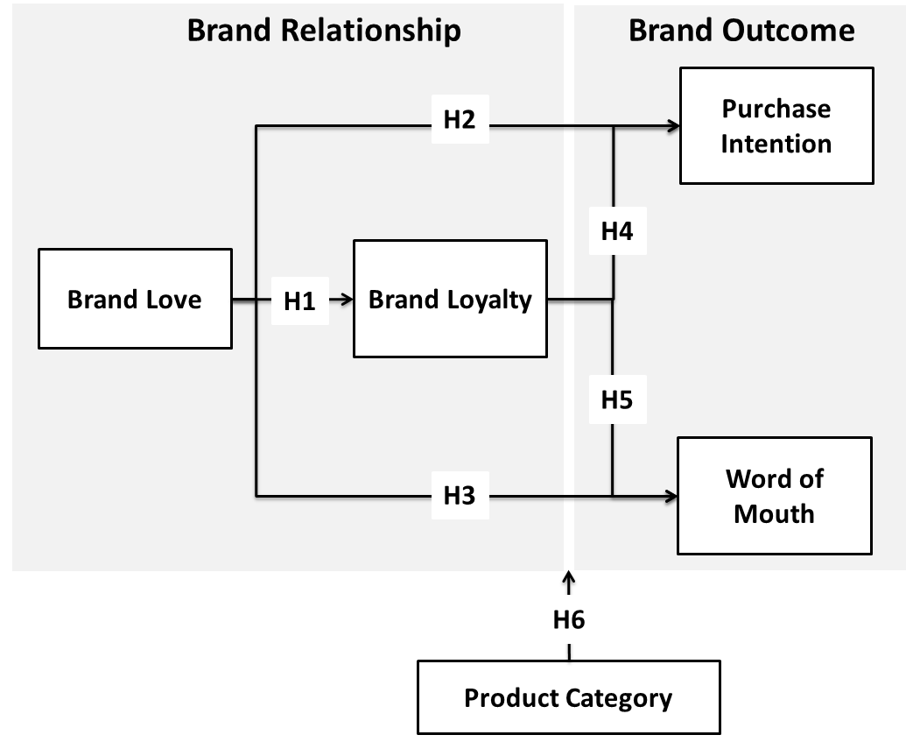
Theoretical Framework
*

Slide 11
Hypotheses (1/3)
The few brand love studies (Thomson et al. 2005; Carroll & Ahuvia, 2006; Batra et al. 2012) show that brand love precedes brand loyalty.
H1: Brand Love positively influences brand loyalty
Several studies demonstrated the positive relationship between brand loyalty and purchase intention (Jacoby & Kyner, 1973; Jacoby & Chestnut, 1978; Tellis, 1988; Srinivasan et al., 2002). Since brand love precedes brand loyalty (Carroll & Ahuvia, 2006) we test the following hypothesis
H2: Brand Love positively influences purchase intention
Most recently, Batra et al. (2012, p. 1) confirm that brand love is “associated with positive word of mouth (WOM). Therefore we state the following hypotheses
H3: Brand Love positively influences word of mouth
*
Notes:
SW-SW-CMZ008-2001-09-27-MFE
*
Brand Relationship and product category. (1) One product category: consumer electronics (Swaminathan et al., 2007), sunglasses (Hayes et al., 2006) (2) multiple product categories (Ji, 2002; Smit et al. 2007; Mai L-we & Conti, 2008; Breivik & Thorbjørnsen, 2008). References of footnotes provided upon request to authors.

Slide 12
Hypotheses (2/3)
Many have explored the positive relationship between brand loyalty and purchase intention (Jacoby & Kyner, 1973; Jacoby & Chestnut, 1978; Tellis, 1988; Srinivasan et al., 2002). We test the following:
H4: Brand loyalty positively influences purchase intention
Dick and Basu (1994) or Frank (1997) found that brand loyalty can add to positive word-of-mouth. The positive and direct relationship between brand loyalty and (positive) word-of-mouth finds further support by Reichheld (2006) and Walsh and Beatty (2007). We state:
H5: Brand loyalty positively influences word-of-mouth
*
Notes:
SW-SW-CMZ008-2001-09-27-MFE
*
Brand Relationship and product category. (1) One product category: consumer electronics (Swaminathan et al., 2007), sunglasses (Hayes et al., 2006) (2) multiple product categories (Ji, 2002; Smit et al. 2007; Mai L-we & Conti, 2008; Breivik & Thorbjørnsen, 2008). References of footnotes provided upon request to authors.

Slide 13
Hypotheses (3/3)
Albert et al. (2008a, p. 1074) “indicate that consumers may treat product categories differently in terms of their ability to generate love feelings” this has not yet been assessed empirically
Limited and contradictory cross-product category research on consumer-brand-relationship and specifically no cross-category study about brand love. Reluctant do develop specific hypotheses concerning what cross-category difference exist. We therefore state:
H6: Product Category influences the relationships between consumers and their brands
*
Notes:
SW-SW-CMZ008-2001-09-27-MFE
*
Brand Relationship and product category. (1) One product category: consumer electronics (Swaminathan et al., 2007), sunglasses (Hayes et al., 2006) (2) multiple product categories (Ji, 2002; Smit et al. 2007; Mai L-we & Conti, 2008; Breivik & Thorbjørnsen, 2008). References of footnotes provided upon request to authors.

Slide 14
Agenda
Introduction
Literature Review
Theoretical Framework and Hypotheses
Methodology and Results
Conclusion and Limitation
*
Notes:
SW-SW-CMZ008-2001-09-27-MFE
*

Slide 15
Sample and Data Collection
Product category
Caroll and Ahuiva (2006): soft drinks, cereals, mobile phones
Albert et al. (2008a): shoes, cars, lingerie, watches, and perfumes
Bergkvist and Bech-Larsen (2010): clothes brand, soft drink, toothpaste…
We selected soft drinks, mobile phones, shoes, and cars
Respondents
200 respondents per product category*
Translation back-translation method by two independent translators to establish translation equivalence (Douglas and Craig, 2007)
Local trained field workers conducted pre-test with 20 respondents
Randomly selected consumers at a shopping mall in a major city in Brazil. The mall is known for the highest flux of consumers in terms of genre, age and social class distribution. Survey conducted from Monday - Sunday between 10am and 10pm in order to obtain variance of profile respondents
* Above min. 17 observations per cell by Cohen (1998), 20 by Hair et al. (1998), or same as the suggested min. sample of 100 by Spector (1992)
*
Notes:
SW-SW-CMZ008-2001-09-27-MFE
*
Brand Relationship and product category. (1) One product category: consumer electronics (Swaminathan et al., 2007), sunglasses (Hayes et al., 2006) (2) multiple product categories (Ji, 2002; Smit et al. 2007; Mai L-we & Conti, 2008; Breivik & Thorbjørnsen, 2008). References of footnotes provided upon request to authors.

Slide 16
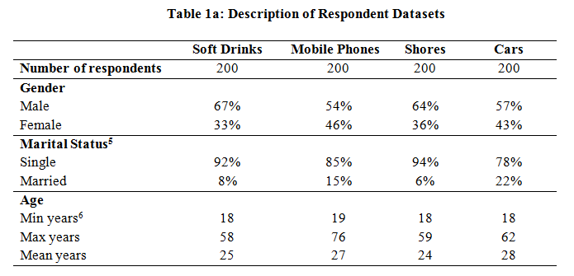
Descriptive Statistics Respondents
*

Slide 17
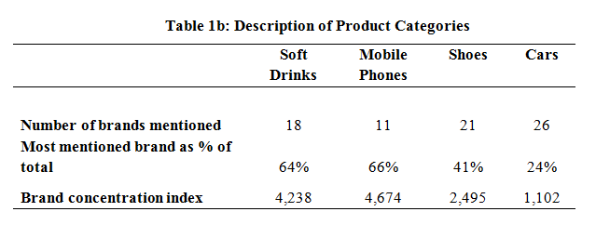
Descriptive Statistics Brand Concentration
*
* Brand concentration index (BCI) characterizes the distribution of the brand ‘market share’ in the mind of the respondents. We used the HHI as a proxy of the perceived degree of brand concentration (Rubio and Yagüe, 2009)
*

Slide 18
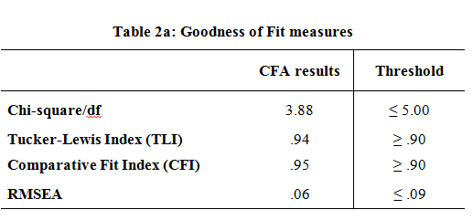
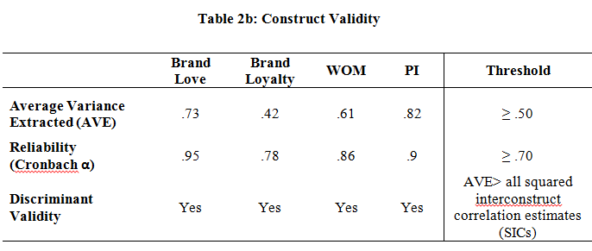
Validity and Reliability
Content validity guaranteed as items based on validated scales
Construct validity, convergent validity as well as discriminant validity by conducting an explorative factor analysis (EFA) with principle components extraction method and varimax rotation
18 of 19 items retained for confirmatory factor analysis (CFA)
Multiple statistical tests to assess validity and reliability of our measurement items and results.
* Brand loyalty with low average variance extracted of .42, indicating that the five items of loyalty do not “converge” very well, meaning they do not share a significant proportion of variance in common. However, there is no single item nor a set of two items of loyalty that, if removed, would improve significantly the model. We decided to keep all 5 items.
*
Notes:
SW-SW-CMZ008-2001-09-27-MFE
*
Brand Relationship and product category. (1) One product category: consumer electronics (Swaminathan et al., 2007), sunglasses (Hayes et al., 2006) (2) multiple product categories (Ji, 2002; Smit et al. 2007; Mai L-we & Conti, 2008; Breivik & Thorbjørnsen, 2008). References of footnotes provided upon request to authors.

Slide 19
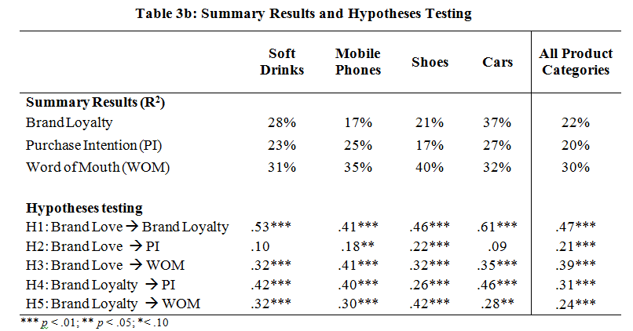
Hypotheses Testing
Sign and directionality suggest brand love is not category specific (except H2)
However, intensity of relationship ; explanation power different
Better model fit for product categories with high BCI (few brands) compared to product category with low BCI (many brands)
Suggest if consumers love a brand, it depends on the difference between brands within a product category rather than between product categories
*

Slide 20
Agenda
Introduction
Literature Review
Theoretical Framework and Hypotheses
Methodology and Results
Conclusion and Limitation
*
Notes:
SW-SW-CMZ008-2001-09-27-MFE
*

Slide 21
Conclusion and Limitation
Advance the research about consumer brand relationship
Assess if product category is relevant for the relationship between consumers and their favorite brands
If there is brand “love”, the product category does not matter
Brand love seems to be influenced by the difference between brands within a product category rather than between product categories
Limitations:
Test with other countries as love is culturally grounded
Other and more product categories
Incorporating other factors that might influence and further explain the concept of brand love
Investigate further within product category brand differences
*
Notes:
SW-SW-CMZ008-2001-09-27-MFE
*
Brand Relationship and product category. (1) One product category: consumer electronics (Swaminathan et al., 2007), sunglasses (Hayes et al., 2006) (2) multiple product categories (Ji, 2002; Smit et al. 2007; Mai L-we & Conti, 2008; Breivik & Thorbjørnsen, 2008). References of footnotes provided upon request to authors.

Slide 22
*

Slide 23
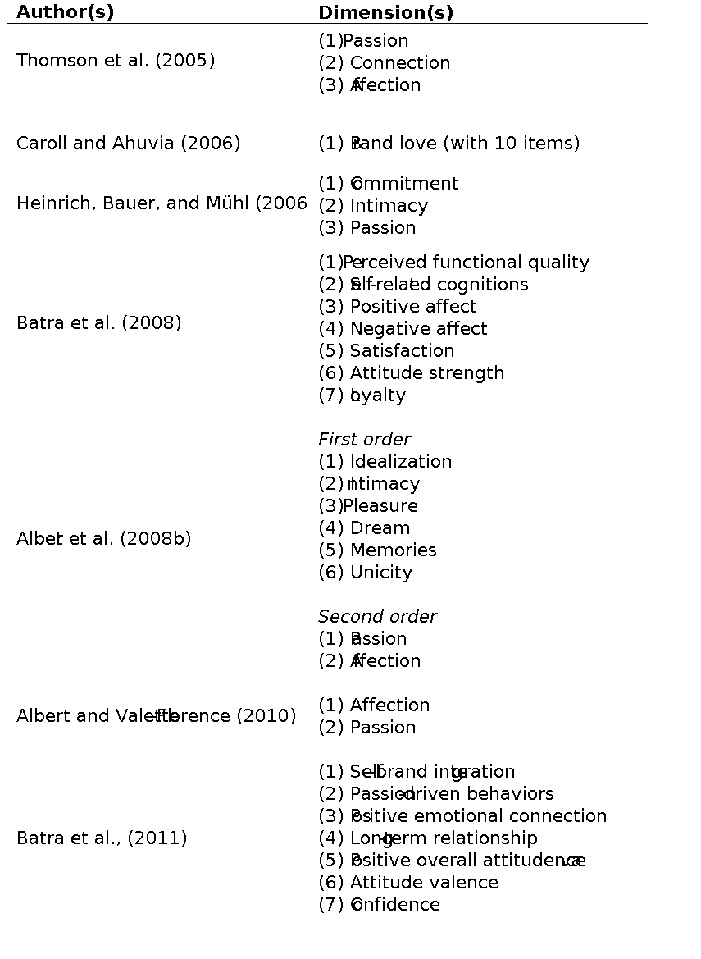
Dimensionality of Brand Love
*

Slide 24
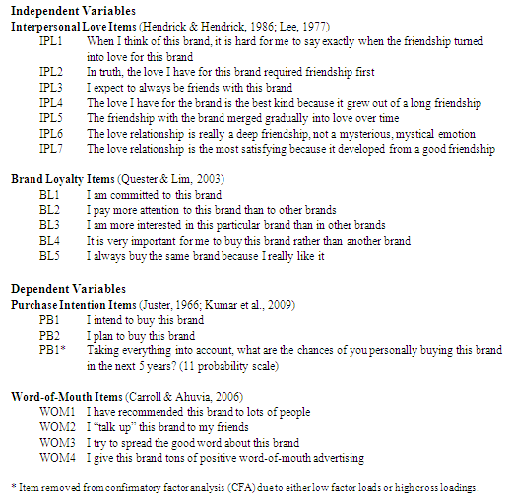
Measurement Items
*

Slide 25
Validity and Reliability By product category
*

Slide 26
References
Aaker, J. (1997). Dimensions of brand personality. Journal of Marketing Research, 34(3), 347-356.
Ahuvia, A. (2005). Beyond the extended self: loved objects and consumers identity narratives. Journal of Consumer Research, 32(June), 171-184.
Albert, N., Merunka, D., & Valette-Florence, P. (2008a). When consumers love their brand: exploring the concept and its dimensions. Journal of Business Research, 61, 1062-1075.
Albert, N., Merunka, D., & Valette-Florence, P. (2008b). The feeling of love toward a brand: concept and measurement. Advances in Consumer Research, 36, 300-307.
Anderson, J., & Gerbing, D. (1988). Structural Equation Modeling in Practice: A Review and Recommended Two-Step Approach. Psychological Bulletin, 103(2), 411-423.
Ashworth, L., Dacin, P., & Thomson, M. (2009). Why on earth do consumers have relationship with marketers?. In: MacInnis D, W. Park W, J. Priester J. editors. Handbook of Brand Relationships. Armonk, New York:M.E. Sharpe, 2009 pp. 82-106.
Batra, R., Ahuvia, A., & Bagozzi, R. (2008). Brand love: its nature and consequences. Working paper; University of Michigan-Dearborn, Ann-Arbor.
Batra, R., Ahuvia, A., & Bagozzi, R. (2012). Brand Love. Journal of Marketing (in print).
Bauer, H., Heinrich, D., & Martin., I. (2007). How to create high emotional consumer-brand relationships? The causalities of brand passion. In: proceedings of the Australian and New Zeland Academy.
Berry, L. (2000). Cultivating service brand equity. Journal of Academy of Marketing Science, 28(1), 128-137.
Bloemer, J.,& Kasper, H. (1995). The complex relationship between consumer satisfaction and brand loyalty. Journal of Economic Psychology, 16(2): 311-329.
Broniarczyk, S., & Alba, J. (1994). The Importance of the Brand in Brand Extension. Journal of Marketing Research, 31(2), 214-228.
Bergkvist, L., & Bech-Larsen, T. (2010). Two studies of consequences and antecedents of brand love. Journal of Brand Management, 17(7), 504-518.
Busacca, B., & Castaldo, S. (2003). Brand knowledge, brand trust and consumer response: a conceptual framework. In: 2nd workshop “Trust within and between organizations special session “Trust in marketing”. Amsterdam.
Carroll, B.A., & Ahuvia, A. (2001). Some antecedents and outcomes of brand love. Marketing Letters, 17(2), 79-89.
Chaudhuri, A., & Holbrook, M.B. (2001). The Chain of effects from brand trust and brand affect to brand performance: the role of brand loyalty. Journal of Marketing, 65(2), 81-93.
Churchill, G. (1979). A Paradigm for developing better measures of marketing constructs. Journal of Marketing Research, 16(February), 64-73.
*

Slide 27
References
Dick. A.S., & Basu, K. (1994). Consumer loyalty: toward an integrated conceptual framework. Journal of the Academy of Marketing Science, 22(Spring), 99–113.
Douglas, S. P. & Craig, C. S. (2007). Collaborative and Iterative Translation: An Alternative Approach to Back Translation. Journal of International Marketing, 15(1), 30-43.
Eagly, A., Chaiken, S. (1993). The psychology of attitudes. Harcourt Brace Jovanovich, Forth Worth, 1993.
Fournier, S. (1997). Consumers and their brands: developing relationship theory in consumer research. Journal of Consumer Research, 24(4), 343-372.
Fournier, S., & Yao, J.L. (1997). Reviving brand loyalty: a reconceptualization within the framework of consumer-brand relationships. International Journal of Research in Marketing, 14(5), 451-72.
Frank, M. (1997). The realities of web-based electronic commerce. Strategy and Leadership, 3(May), 30–32.
Garbarino, E., & Johnson, M.S. (1999). The roles of satisfaction, trust, and commitment in consumer relationships. Journal of Marketing, 63(2), 70-87.
Hendrick, C. & Hendrick, S. (1986). A theory and method of love. Journal of Personality and Social Psychology, 50(2), 392-402.
Jacoby, J. & Kyner, D. (1973). Brand loyalty vs. repeat purchasing behavior. Journal of Marketing Research, 10(1), 1-9.
Jacoby, J., & Chestnut, R. (1978). Brand loyalty measurement and management. New York: Wiley.
Juster , F.T. (1966). Consumer buying intention and purchase probability. National Bureau of Economic Research, Columbia University Press.
Keh, H.T., Pang, J. & Peng, S. (2007). Understanding and measuring brand love. In proceedings of the Advertising and Consumer Psychology conference, New Frontiers in Branding: Attitudes, Attachments, and Relationships. Santa Monica, CA.
Keller, K. (1993). Conceptualizing, measuring, and managing consumer-based brand equity. Journal of Marketing, 57, 1–22.
Kumar, A., Lee, H-J., & Kim, Y.K. (2009). Indian consumers' purchase intention toward a United States versus local brand. Journal of Business Research, 62(5), 521-527.
Malhotra, N.K., Agarwal, K., & Peterson, M. (1996). Methodological issues in cross-cultural marketing A state-of-the-art review. International Marketing Review, 13(5), 7-43.
Maxham, J .G. & Netemeyer, R.G. (2002). A longitudinal study of complaining consumers' evaluations of multiple service failures and recovery efforts. Journal of Marketing, 66(4), 57-71.
Miniard, P.W., Obermiller, C., & Page, T.J. (1983). A further assessment of measurement influence on the intention-behavior relationship. Journal of Marketing Research, 20(2), 206-213.
*

Slide 28
References
Newman, L.H., & Dolich, I. (1979). Examination of Ego-Involvement as a Modifier of Attitude Change Caused From Product Testing. Advances in Consumer Research, 6, 180-183.
Quester, P.G., & Lim, A.L. (2003). Production involvement/brand loyalty: Is there a link?. Journal of Product & Brand Management, 12(1), 22-38.
Park, C., MacInnis, D., Priester, J., Eisengerich, A., & Iacabucci, D. (2010). Brand Attachment and Brand Attitude Strength: Conceptual and Empirical Differentiation of Two Critical Brand Equity Drivers. Journal of Marketing, 74, 1–17.
Reichheld, F. (2006). The ultimate question: driving good profits and true growth, Boston, MA: Harvard Business School Press.
Sekaran, U. (1983). Methodological and theoretical issues in cross-cultural research. Journal of International Business Studies, 14(2), 61-73.
Singh, J. (1990). Voice, exit, and negative word-of-mouth behaviors: an investigation across three service categories. Journal of the Academy of Marketing Science, 18(1), 1-15.
Srinivasan, S. , Anderson, R., & Ponnavolu, K. (2002). Consumer loyalty in E-commerce: an exploration of its antecedents and consequences. Journal of Retailing, 27, 279-295.
Sujan, M. (1985). Effects on Evaluation Strategies Mediating Consumer Judgement. Journal of Consumer Research, 12(June), 31-46.
Swaminathan, V., Page, K.L. & Gürhan‐Canli, Z. (2007). "My" brand or "your" brand: the effects of brand relationship dimensions and self-construal on brand evaluations. Journal of Consumer Research, 34(2), 248-259.
Tellis, G.J. (1988). Advertising exposure, loyalty and brand purchase: a two stage model of choice. Journal of Marketing Research, 25, 134-144.
Thomson, M., MacInnis, D.J., & Park, C.W. (2005). The ties that bind: measuring the strength of consumers emotional attachment to brands. Journal of Consumer Psychology, 15, 77-91.
VanTrijp, H., Hoyer, W.D., & Inman, J. (1996). Why Switch? Product Category: Level Explanations for True Variety-Seeking Behavior. Journal of Marketing Research, 33(3), 281-292.
Wangenheim, F., & Bayon, T. (2004). Satisfaction, loyalty and word of mouth within the consumer base of a utility provider: differences between stayers, switchers and referral switchers. Journal of Consumer Behaviour, 3(3), 211-220.
Walsh, G., & Beatty, S. E. (2007). Customer-based corporate reputation of a service firm. Journal of the Academy of Marketing Science, 35(1)
*

