Slide 1
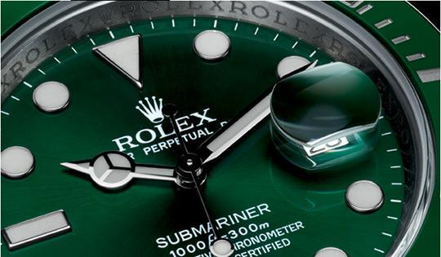
What’s this thing called Love?
Exploring the relationship between brand love, personality, and the propensity to anthropomorphize.
Ronald Voorn and Sabrina Hegner
CBR Conference, Rollins College, Orlando , Florida.
Sep 27th, 2013

Slide 2
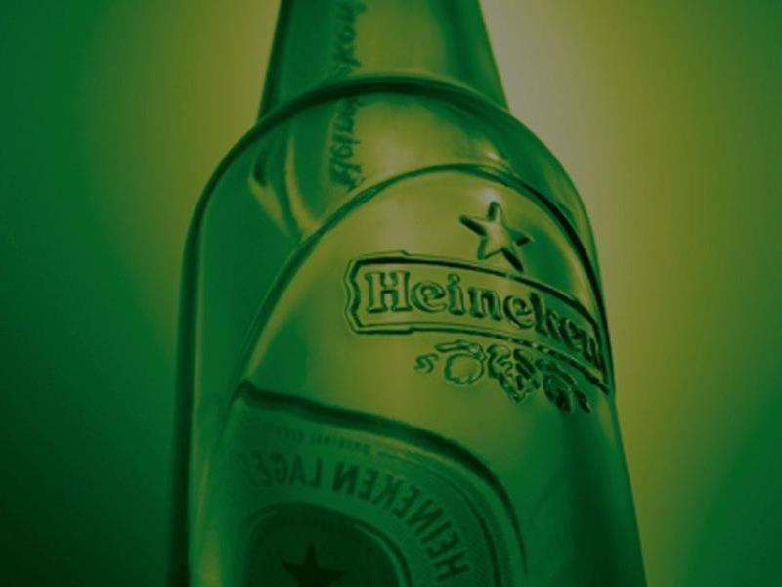
Content
Introduction
Research Questions
Brand Love and Big 5
Anthropomorphisation
Product Grid
Hypotheses and Model
Results
Discussion

Slide 3
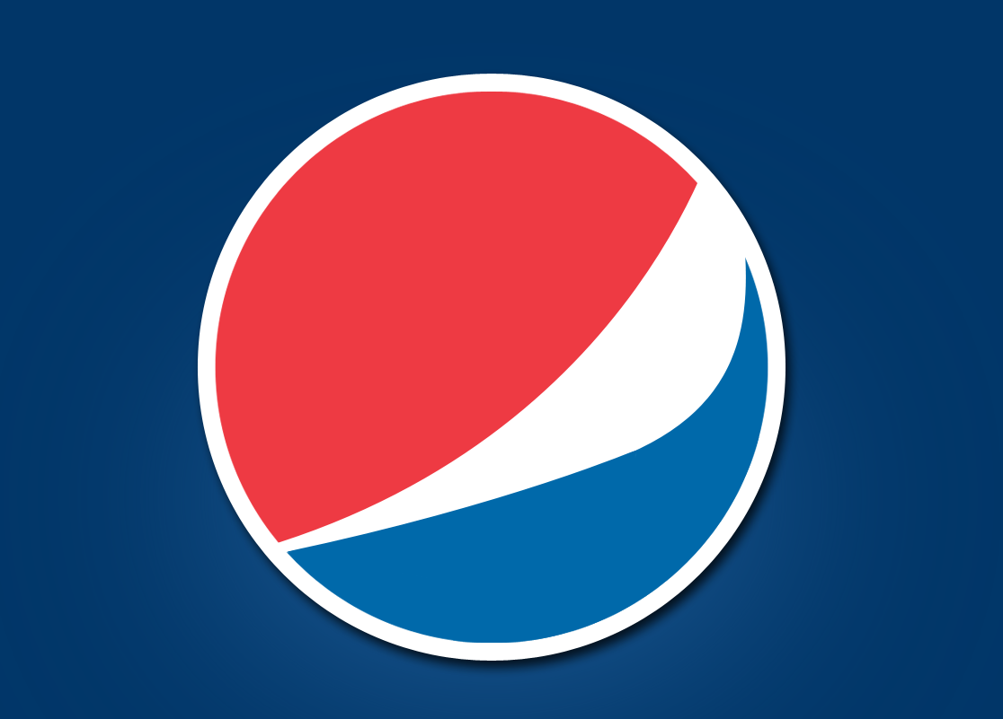
Involved with brands since 1979
Ronald Voorn MSc.
1.0 : Advertising
2.0 : Marketing
3.0 : CEO
4.0 : PhD student/Lecturer

Slide 5
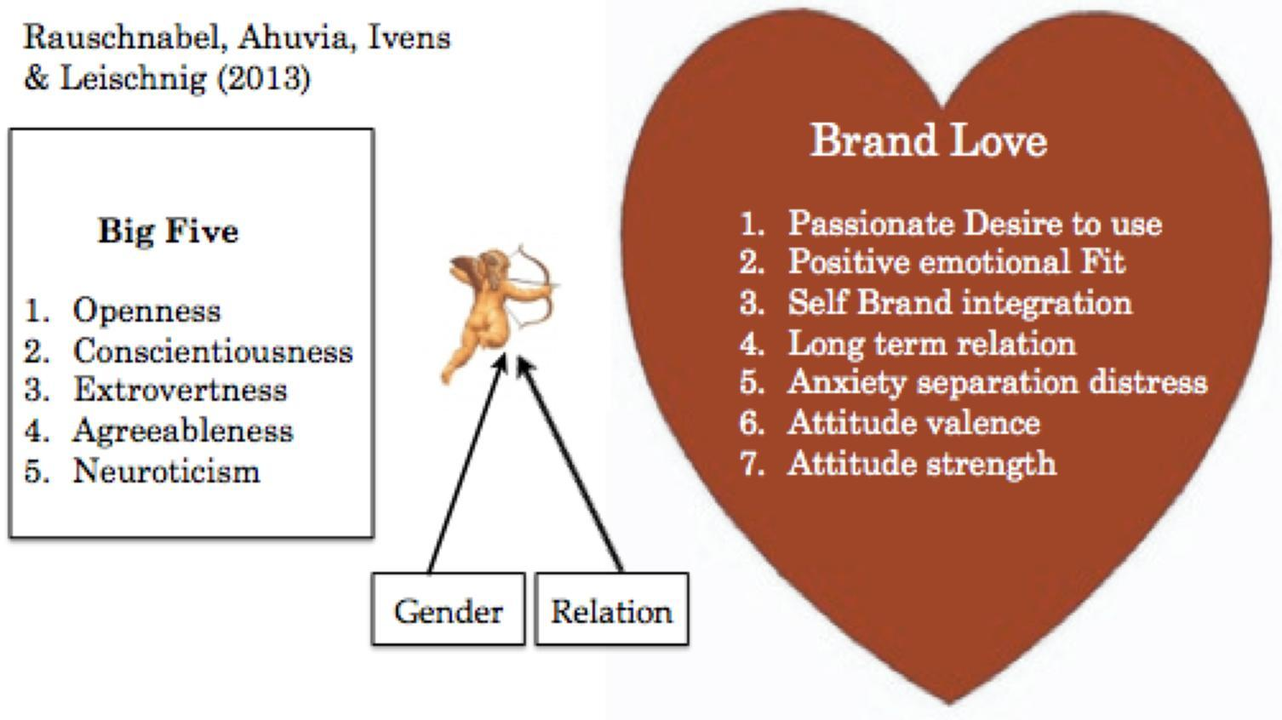

Slide 6
Research Questions
RQ1: To what extent does personality influence Brand Love (the BAB prototype and its seven antecedent elements )
RQ2: To what extent does the propensity to anthropomorphize mediate the influence of personality on the brand love prototype
RQ3: To what extent does the consumer’s categorization of products directly influence the brand love scores

Slide 7
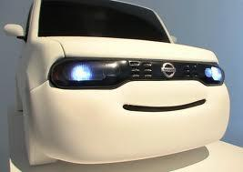
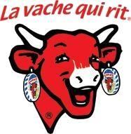
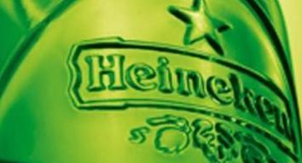
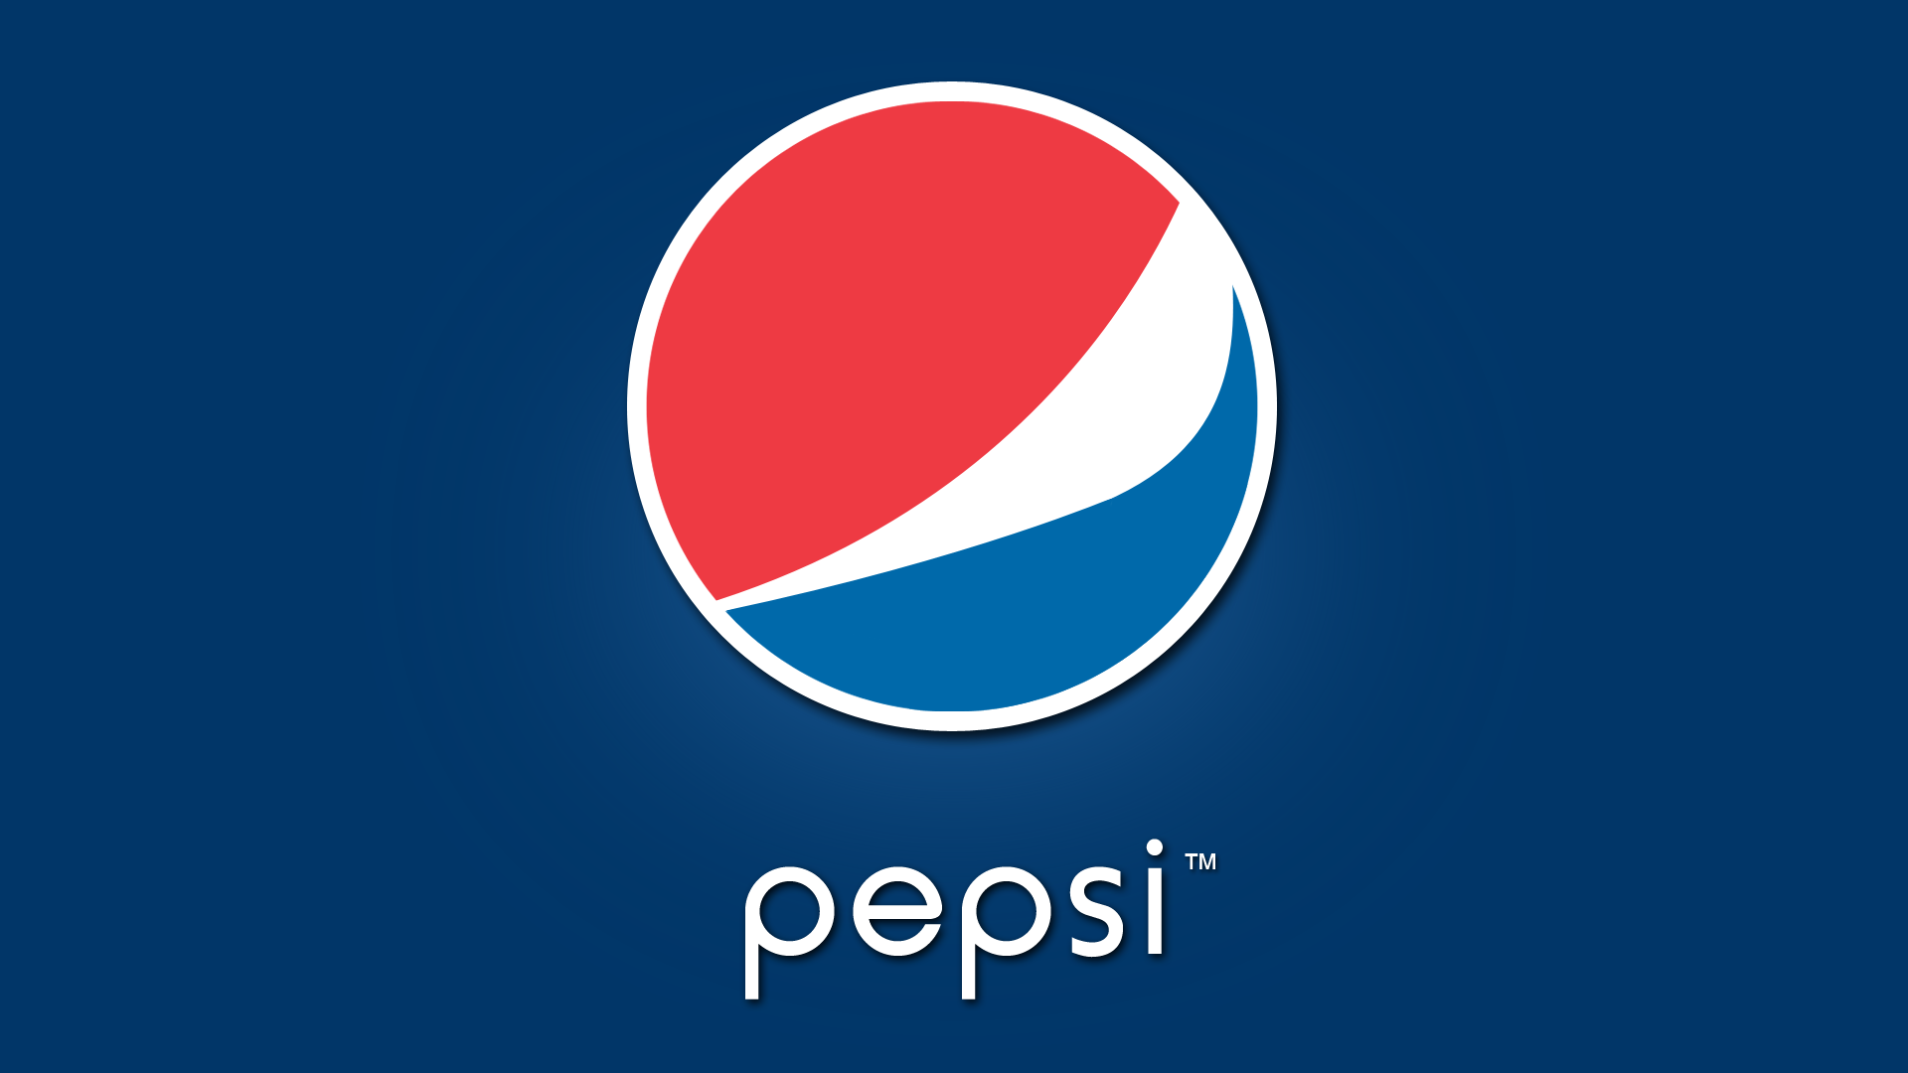
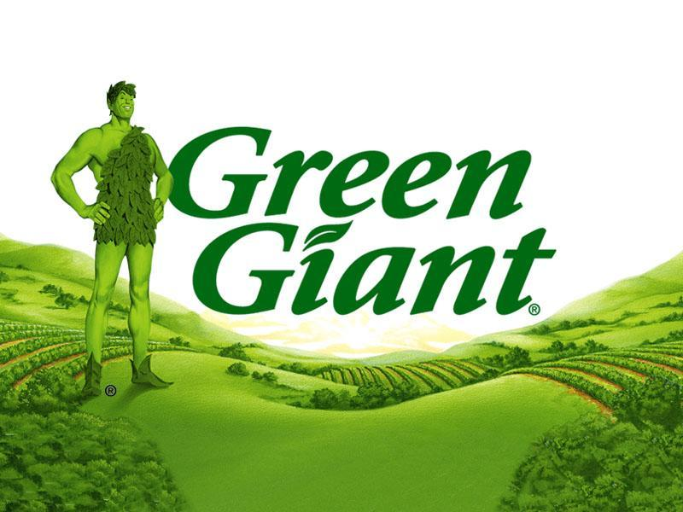
Anthropomorphisation

Slide 8
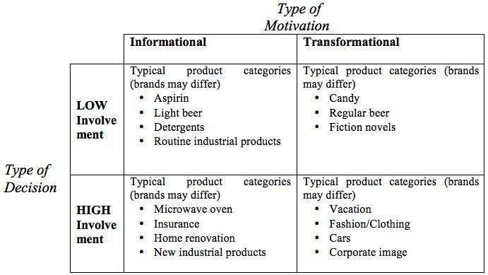
Rossiter Percy Grid (1991)

Slide 9
Hypotheses
H1: Extroversion is positively associated with brand love
H2: Neuroticism is positively associated with brand love
H3: The relation between personality and brand love is mediated by the propensity to apply ATP
H4 Brands that belong to the high involvement category will receive higher scores on brand love
H5: Brands that belong to the transformational category will receive higher scores on brand love than informational brands

Slide 10
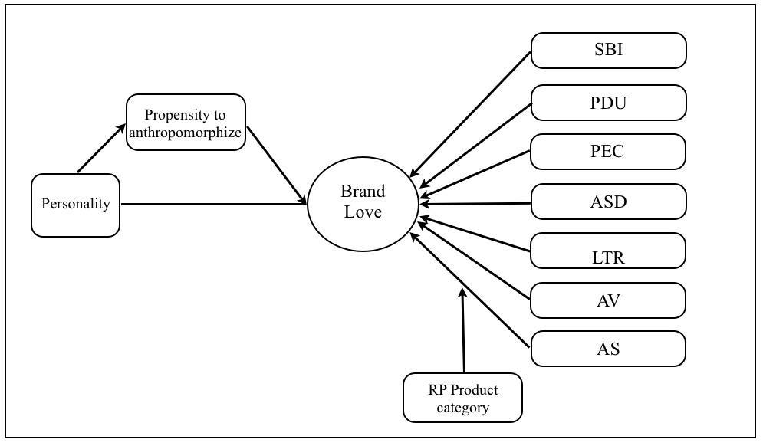

Slide 11
Results
The higher openness, the higher brand love

Slide 12
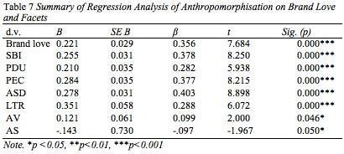
ATP no mediator but the higher ATP the higher brand love
High involvement and transformational products indeed score higher on brand love

Slide 13
Recommendations
Clear evidence ATP can have a positive effect on brand love scores.
If practitioners do not actively manage this process it might lead to non-desirable outcomes for their brands
Need to apply ATP cues towards the architecture of their brands by design.
Especially helpful to lower involvement and informational products in obtaining more brand love.

Slide 14
Practitioners could offer more opportunities for consumers to anthropomorphize through:
visual or other cues like the tone of voice in their marketing communication efforts,
the sort of activities, sports or athletes they sponsor,
the type of sales promotion offers
the personas they develop for their social media activities or
the kind of actors they select in their TV-commercials

Slide 15
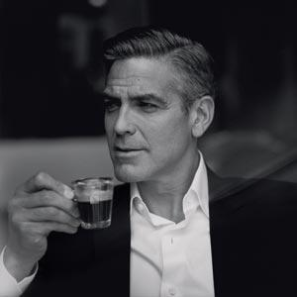
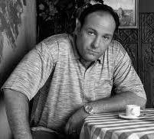
Because the one Nespresso is not the other one

